Slide 1


INTRODUCTION
DECIDERS
Designed, developed and presented by:
SNEHA.K 3BR22AI153
SWATI SAHU 3BR22AI163
SREELATHA 3BR22AI154
SUSHMITA VISHWAKARMA 3BR22AI162

Slide 2


Slide 3

CONTENT
1 | CLOUD SERVICE
2 | SERVICE AVAILABILITY
3 | PERFORMANCE METRICS
4 | PROJECT DEMO
5 | PROS AND CONS
6 | CONCLUSION

Slide 4

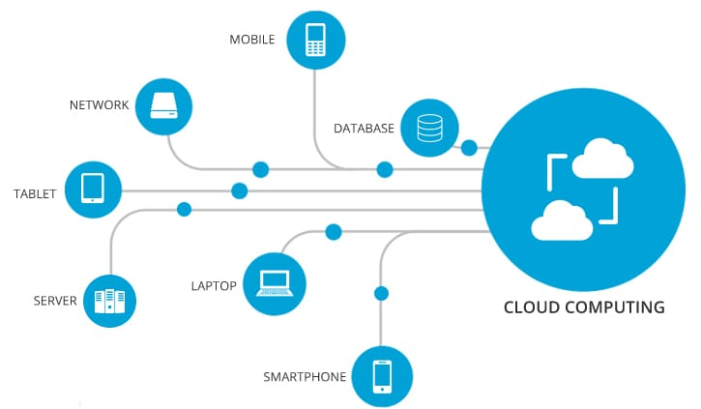
What is cloud service?
Centralized platform for real-time insights into cloud service performance.
Visual representation of uptime, response time, and error rates
Enables proactive issue identification and optimization of resources.
Facilitates seamless user experience and effective cloud infrastructure management.

Slide 5

SERVICE AVAILABILITY
Real time monitoring
Historical reporting
Proactive notifications
Automated failover

Slide 6
PERFORMANCE METRICS
Response times
Track the speed of your cloud services with detailed metrics on request latency and page load times.
Resource utilisation
Error rates
Identify and investigate any spikes in error messages or failed requests to maintain high availability
Monitor CPU, memory, and storage usage to ensure your infrastructure is operating efficiently.
PERFORMANCE METRICS

Slide 7

PROJECT DEMO
MODULES
CloudService
CloudServiceDashboard
CLASS
Import os
Import datetime
FUNCTION
Create_service
Read_service

Slide 8
pros
-> Catch problems early
-> See everything at a glance
cons
->Information Overload
->Limited Control
->False Alarms
->Security Concerns
->Work from anywhere
->Makes managing cloud easier

Slide 9

CONCLUSION
The conclusion of a cloud service health dashboard typically summarizes the overall performance and availability of the cloud services monitored. It may include key metrics such as uptime percentage, response times, incidents detected and resolved, and any notable trends or patterns observed. Additionally, it might outline recommendations for improvement or areas of focus for future maintenance.

Slide 10

ANY QUERIES

Slide 11


